Slide 1
DEVELOP AN OUTCOME L2
Evidence of Learning Template
0136628914
Guess the song quiz
Ava Paynter

Slide 2
https://docs.google.com/document/d/1fiwzRqHb4ZRJvtTYBg8xgfQhCY2V1c0hxE-vyvrB4Q8/edit?usp=sharing
Check my docs for my planning

Slide 3
Project management: tools
I tried using trello to plan my work but found that this website didn’t suit my style of planning as I didn’t like how it sectioned all the information off daily and then grouped it into weeks and how many different files I had to open to find what I had been working on. I decided to not use trello as it was to regimented for my style of planning.
I decided not to use a set program for planning as i looked into trello witch looked great for collaborating in a teams and groups but since I am doing thi stask individually I found a simple google docs easy to use and share I find having all the information in front of me readily available easy to plan with.

Slide 4
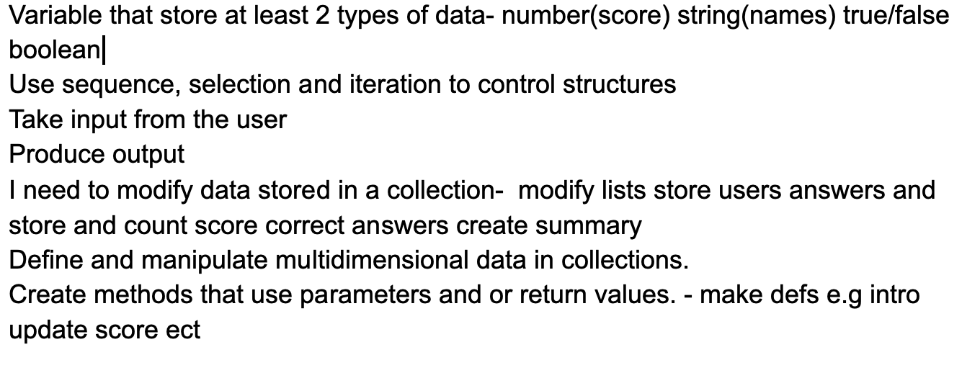
Project management: Setup
Record evidence that you have chosen project management Techniques to manage the development of your outcome.
When starting the task I went through the marking schedule and broke it down I went through and found what i needed to include in my program for a passing grade. I recorded what I needed to include in my task and how I would write my code to include these . i did this in my google docs her is the list.

Slide 5
Project management: Setup
*Record evidence that you have setup/ chosen version control tools/techniques to manage the development of your outcome. I forgot to use version control tool but luckily since I used pycharm it automatically saved my different versions of my code. So I was able to go back and view my different versions.To make sure I stayed on track I created a plan in my googledocs of things I needed to get done each week.
Explain why you believe that these tools and techniques are appropriate for the development of your outcome. As I had a plan each week of things I needed to do this allowed me to stay on track and to complete my assignment successfully.

Slide 6
Decomposing outcome
Record evidence that you have broken the outcome into smaller components.
To start my project I made a list of things I needed to include in my project to get a passing grade to ensure I did not miss anything I made sure to ask Ms Bharani if I had included everything and to give some examples. This really helped me start my planning. I made sure to write a detailed list with example of ways i could include components and selected the best suiting one for my quiz.

Slide 7
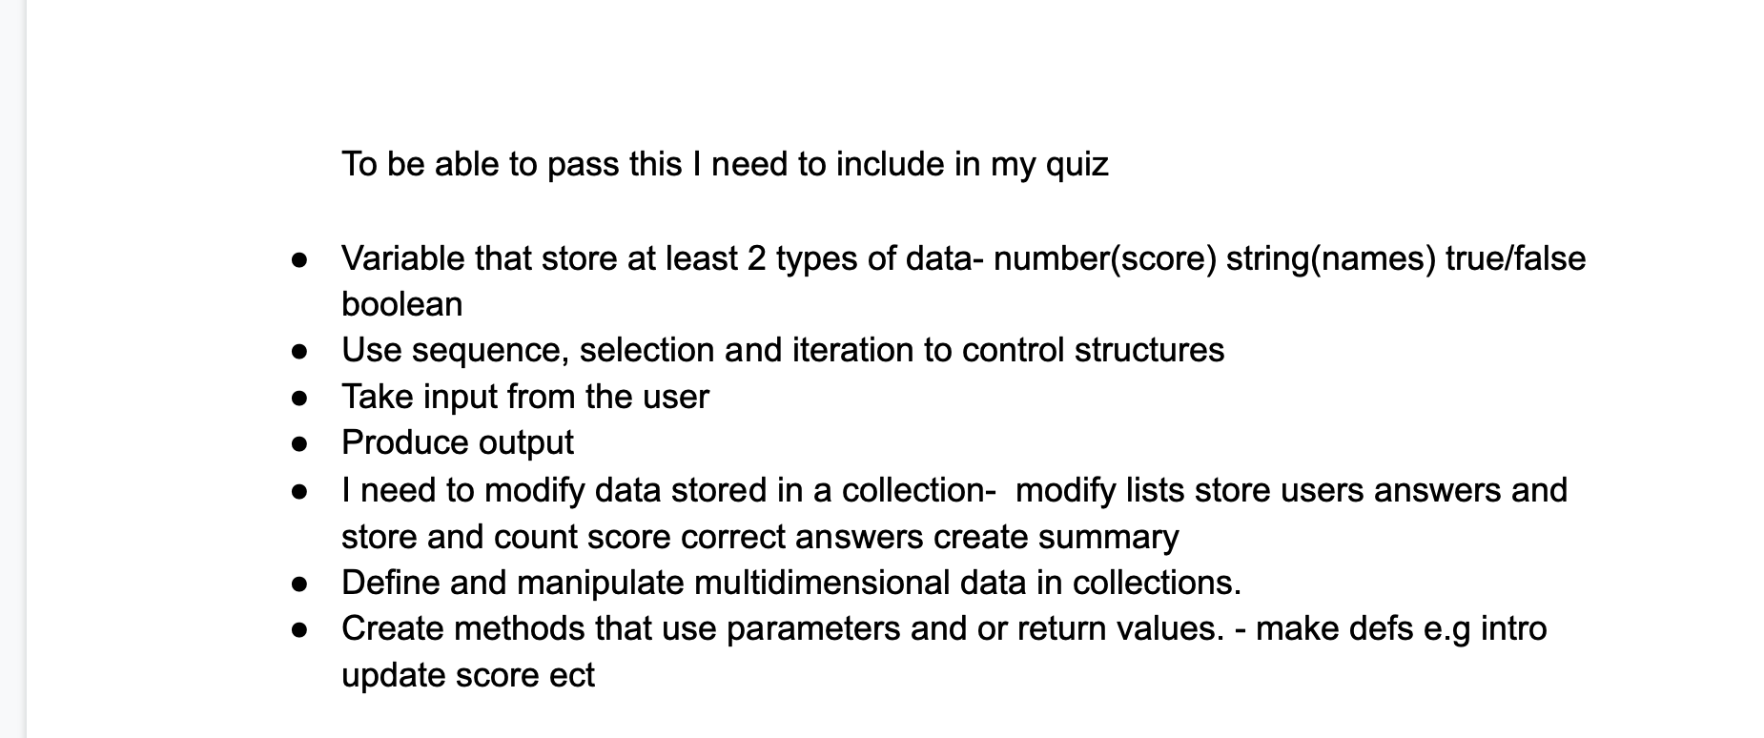
List of components

Slide 8
Trialling components
Record evidence that you have trialled components. Show that you gathered information to inform your decision making. With my quiz I needed to use an outside library to play my songs I researched some options and found playsound(), pydub and tksnack to be the most commonly used sound modules.
Record evidence that you have trialled multiple components and have selected those most suitable. I found out of these three that playsound was the easiest to use as in pydub you can only use .wav files and I was using mp3 files and tksnack you had to use tkinter to be able to use tk snack. Out of three sound components i found playsound() the easiest and best suited to my quiz . code snippets next slide

Slide 9
Trialing components - playsound(), pydub and tksnack
I trialled tksnack, playsound and pydub and found playsound to be the easiest to use and best suited for my quiz as it didnt take up as mych storage was easy to code and was easy to work with mp3 files
And with a bit of research on tksnack i found that it is best if you want to combine songs and do more complex things with them. I decided not to use tk snack as I just needed something simple
from playsound import playsound
playsound('/path/to/a/sound/file/you/want/to/play.mp3')
-I found playsound very easy to use and it worked well with pycharm. As it is small and compressed and is simple to work with
I found pydub also okay but thought it would not work as well in my def functions and it is a nuisance having to convert files into wav format. Wav format has better audio quality but i did not need amazing quality and also it takes up more space.
from pydub import AudioSegment song = AudioSegment.from_wav("never_gonna_give_you_up.wav")
-

Slide 10
Testing outcome
Record evidence that you have tested your outcome.
Explain how the testing made sure your outcome functions as intended to meet its purpose and requirements.
I have 4 different versions of my quiz
First is a basic quiz setup this was my structure that I decided on
My separate codes my running song playing and then my running quiz
Then was my song quiz working properly
And then was any additional code that i changed after feedback
Record evidence that you have used information from testing appropriately to improve the functionality of the outcome.

Slide 11
Testing outcome - debugging - pep8
Use ss
Usability testing- peer testing
Code validation
Proof reaxing
Evaluating against requirments
Evualuatimng against relevant implications
Final testing of the code

Slide 12
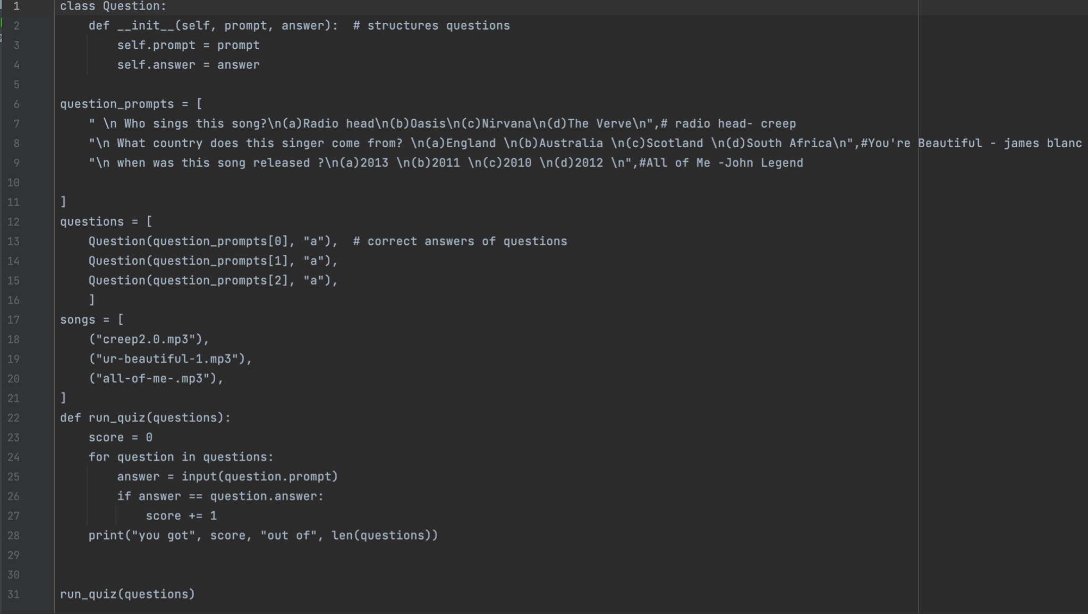
Basic code
I started with a basic quiz that uses lists. this is the first version of my quiz and the structure of my quiz that I would continue to use.
From here on I added all my features

Slide 13
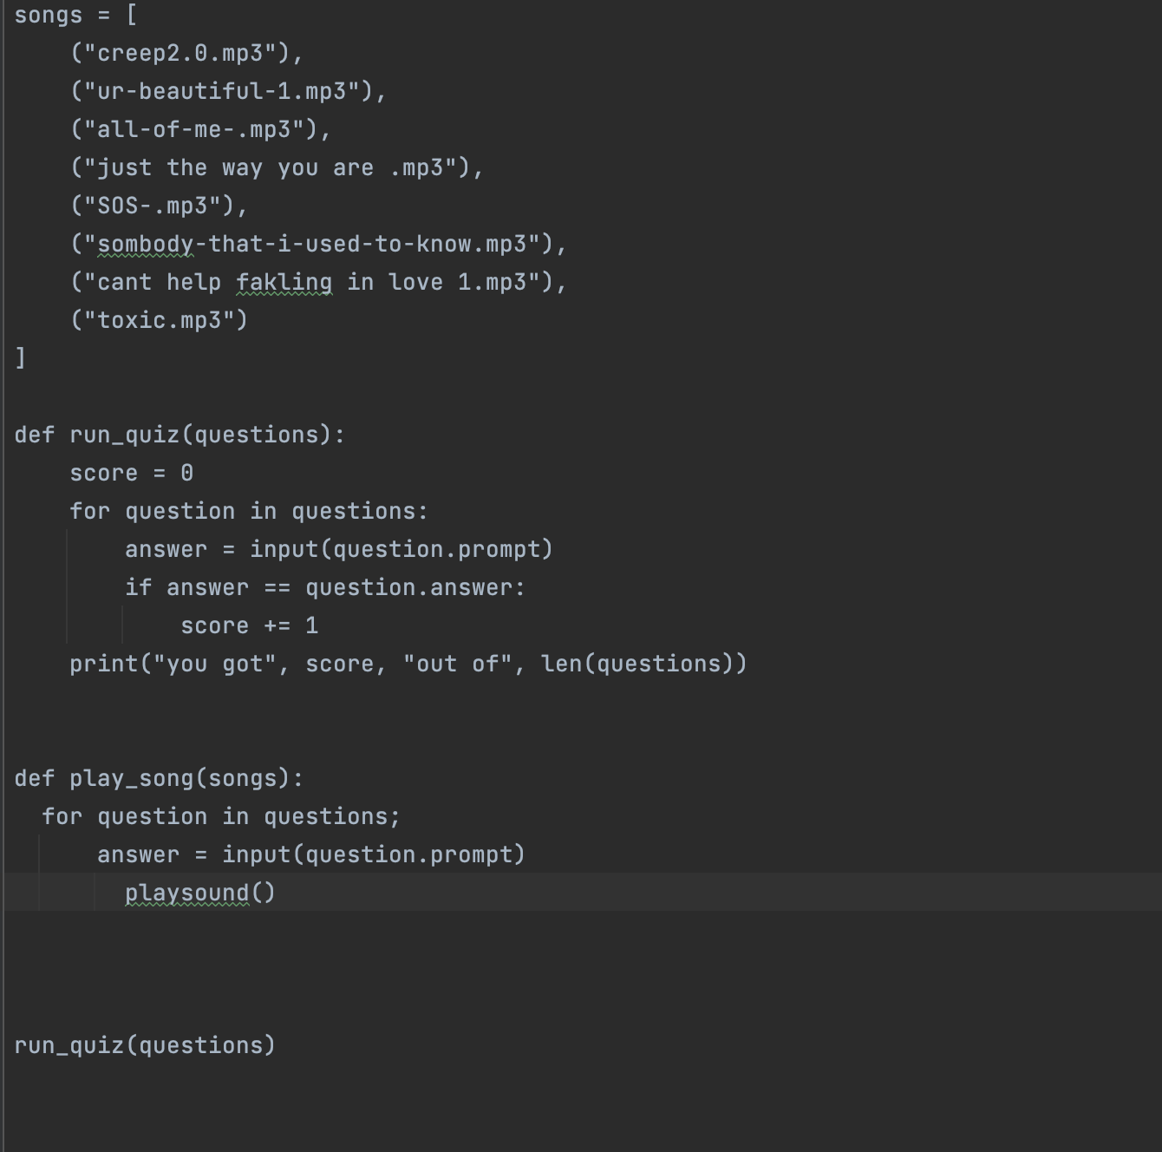
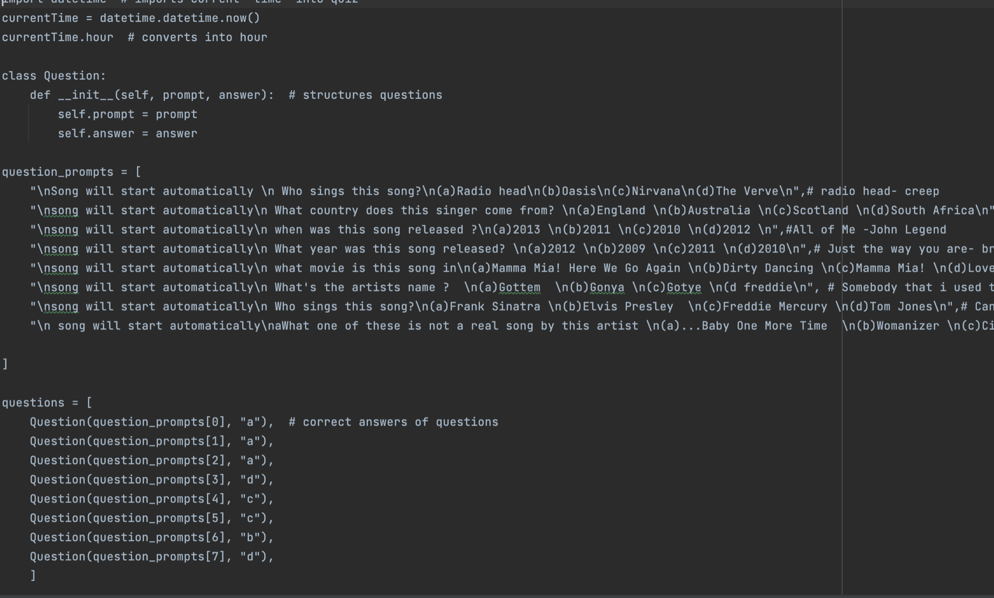
Separate
This is when my quiz and music where running, but separately I still needed to link them together

Slide 14
Running code
def run_quiz(questions): # runs quiz
score = 0
count =0
for question in questions:
global question_prompts
pygame.mixer.init()
pygame.mixer.music.load(songs[count]) #orders songs
pygame.mixer.music.play()
answer = input(question.prompt) # starts questions
if answer == question.answer: #if user inputs correct answer it will print correct
score += 1
print("Well done!") #prints well done
else:
print("wrong")
pygame.mixer.music.stop()
count += 1 #adds one to count for songs
print("you got", score, "out of", len(questions)) #tells users score
This is the def function i wrote to link my score and my songs.
I did this by adding a count function which worked for my song list so whenever a player answered a question it would add one to the score and the count and move on to the next question and song at the same time.

Slide 15
changed/ final code
def intro(): # def function
invalid = 0
print("Hello welcome to my quiz.") # welcomes user
firstname = input("what's your name?") # asks user name
while invalid == 0:
start_answer = input("To start the Quiz(type yes or no)") # when user presses enter quiz will start
if start_answer == "yes": #continues quiz if users types yes
invalid = 1
run_quiz(questions)
elif start_answer == "no": #discontinues quiz if user inputs no
invalid = 2
print("sorry to hear that.")
break #breaks quiz
else:
invalid = 0 #any other input question will repeat
intro()
I then added in an intro to welcome user and give them the option to leave the quiz if they want to.

Slide 16
Usability testing
I asked some of my friends who do not take digital technology to take my quiz and they all enjoyed it some of my feedback was.
“I enjoyed your singing and the structure of the quiz but i think it needs a better welcome it feel a bit of an abrupt start and intro”- kate grubi
“ ha ha your singing was great!, maybe add some different style of questions as they are all quite similar.”-Maddy Walker
“Great quiz enjoyed it!, it feels quite short maybe add some more stuff around it.”- Ella Sykes

Slide 17
Usability testing
After getting my friends feedback I made sure to sort through it and gather pints i could use to improve my quiz. These where
Make quiz longer
Change up some questions
Add in a longer introduction.

Slide 18
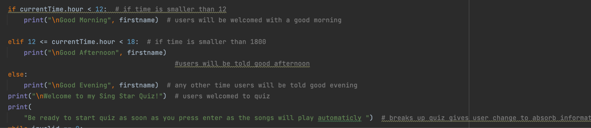
Improving intro
The first bit of advice i took was improving the introduction I did this by adding in a greeting that was different depending on what time of day it was to make the quiz cooler and more entertaining and more user friendly.

Slide 19
More range in questions
Another bit of feedback i got was that the questions i have where to similar and it would be better if I had a larger range of questions.
To improve my questions i first looked at the ones I already had. I must admit they are all quite similar
Who sings this song?
Who sings this song?(a)Radio head(b)Oasis(c)Nirvana(d)The Verve",# radio head- creep
What country does this singer come from? (a)England (b)Australia (c)Scotland (d)South Africa",#You're Beautiful - james blanc
Who wrote this song ?(a)lady gaga (b)celene dion(c)john legend (d)bruno mars ",#All of Me -John Legend
What year was this song released? (a)2012 (b)2009 (c)2011 (d)2010",# Just the way you are- bruno mars
Who wrote this song? (a)Mamma Mia! Here We Go Again (b)Dirty Dancing (c)Mamma Mia! (d)Love Actually", # SOS - ABBA
What's the artists name ? (a)Gottem (b)Gonya (c)Gotye (d freddie", # Somebody that i used to know - Gotyem
"\ Who sings this song?(a)Frank Sinatra (b)Elvis Presley (c)Freddie Mercury (d)Tom Jones",# Can't Help Falling in Love - Elvis Presley.
"A what is th emost famous song by this artist?(a)...Baby One More Time (b)Womanizer (c)Circus (d)Infamous",#Toxic -britney spears

Slide 20
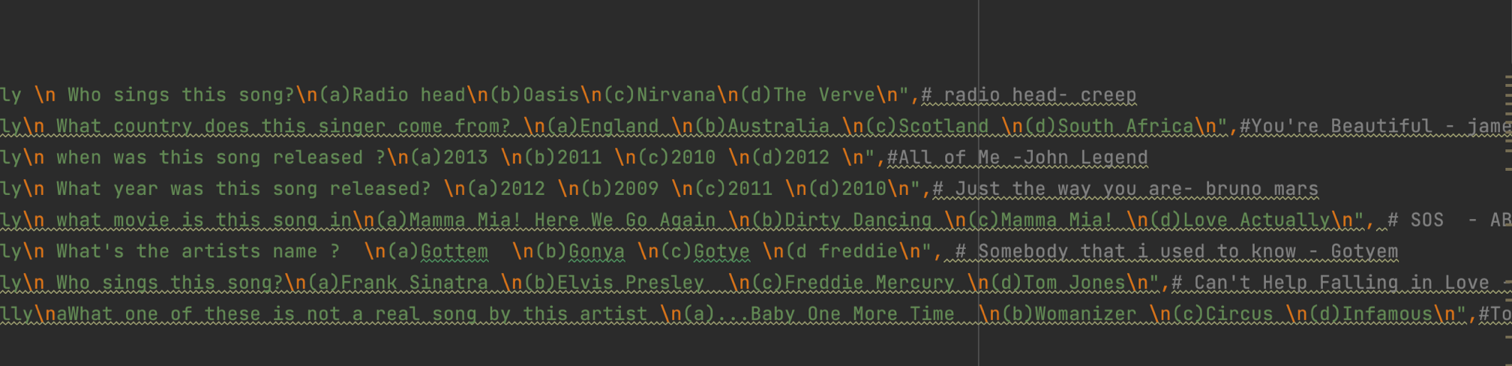
More range of questions
These are my improved questions i made sure to ask about dates and movies and other interesting topic rather than the same boring “who sung this song” this is a major improvement from my previous questions.

Slide 21
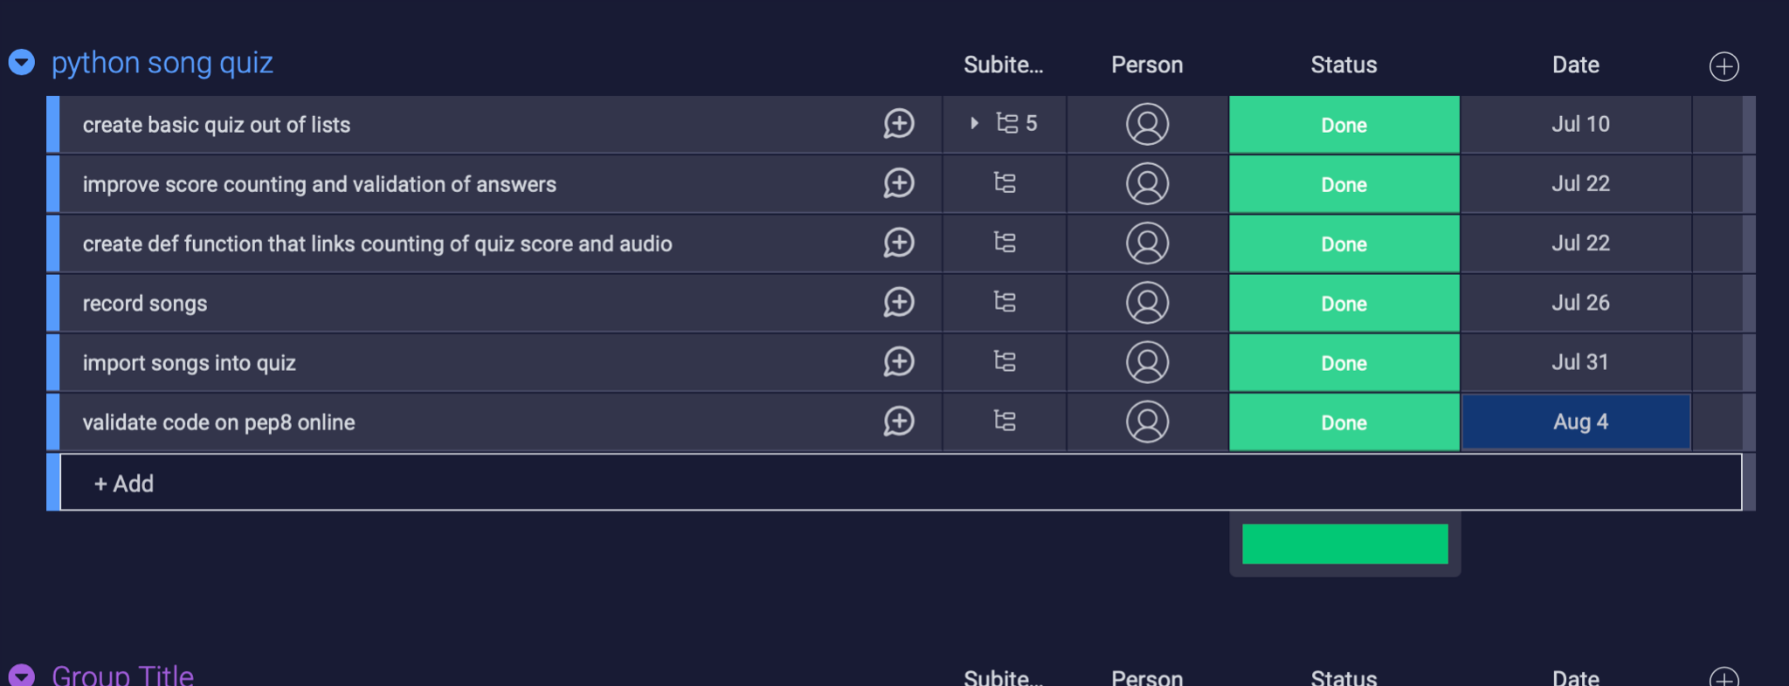
Project management: Applied
Record evidence that you have used your project management tools to manage the development of your outcome. I used monday.com which is an online planner that helps organise your worlk and plan your project well. It helped me set dates for my deadlines and to organise my work into sections

Slide 22
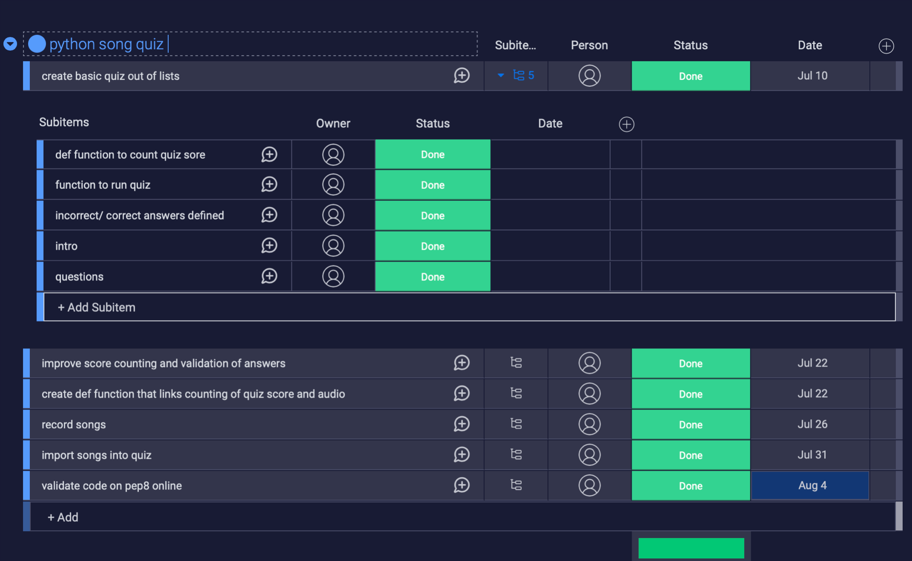
Project management: Applied
Record evidence that you have used your project management techniques to manage the development of your outcome.To ensure i properly managed the development of my quiz i made sure to use deadlines that i set at the beginning of my project and work as hard as i could to meet these. I did this on monday.com and this helped me hit the standard i wanted and finish my quiz on time.

Slide 23
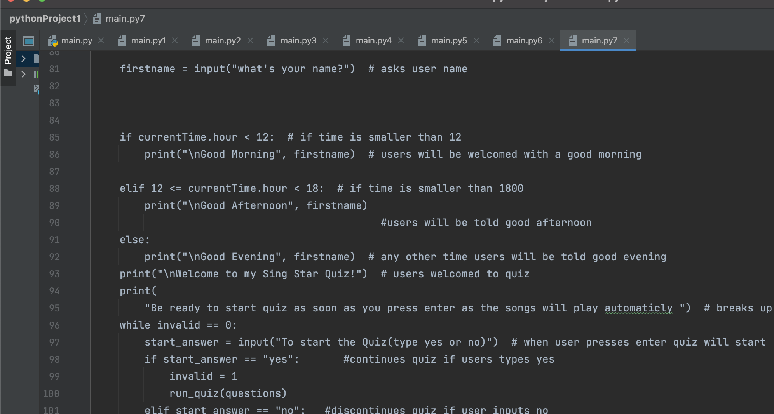
Version Control
As I used pycharm for my quiz it automatically saves versions of your quiz you can go back to and check on. I made sure to save my quiz after completing an item on my list and numbering it by the end i had 7 different versions that i used to look back at when making any changes. Here is a link to all my versions.
As you can see up the top of the image i have 7 different versions of code i have saved while completing the project

Slide 24
Relevant Implications
Explain the relevant implications here. Please watch this video to learn how to do this.
Explain the Implications that are relevant to your outcome.
Record evidence that you have addressed the Implications that are relevant to your outcome. For my quiz i wanted to have a easy to understand, socially relevant fun quiz that people who are ages 10+ and who have a basic grasp on current music and big hits should be able to easily use

Slide 25
Acsessiblility
I wanted to make sure that the design for my quiz is easy for all users to use.
I made sure that my quiz had big readable font. I did this by trialing out different types of font and asking other classmates what they like the best.
I also made sure to explain how to use my quiz to avoid any confusion for users. I did this by having a well explained intro letting users know songs will automatically play and they will end when you have answered the question. I made sure to do this so it is a user friendly quiz and it caters to a larger audience if more people can easily use my quiz more people will do it.

Slide 26
Interlectiual property
Since I was doing a song quiz I have to use other peoples work this breeches the copyright act and i cannot just record artists songs and use them in my quiz but i found since it is non commercial and i do not make any money of it i am allowed to use the artists songs as it is for educational purposes. If i was to make the quiz and publish it outside of school i woul have to ask the companies and pay them to use there songs.

Slide 27
Social
Social implications is making sure you do not offend or affect any social group. Social groups have to do with age, ethnicity, gender, religious beleifs and status. To make sure i did not offend any groups i made sure to pick mainstream well loved artists that are not known for anything bad. I made sure to pick songs that had no profound/ bad language and i made sure to include any songs that included anything to do with race, religion or gender.

Slide 28
Privacy
In the quiz i ask for the users name. For the sake and safety of the user i make sure no third party i use has access to any private information the user is giving up. To do this i make sure to research the apps and add ons i use. In my quiz i use pycharm and pydub and both these softwares are mainstream and safe for all users.

Slide 29
Evaluate
Discuss how the information from planning, testing and trialling of components assisted in the development of a high-quality outcome.
As right from the start i had a good understanding of what needed to be done. From decomposing my outcome to make a list of components i needed to include and then using monday.com to make a list and set deadlines. I had a good idea of time frames and what i needed to accomplish in a certain amount of time. I tested my quiz on friends and students. I also made sure to use code validation software like PEP8 online . I also improved my quiz drastically thanks to the feedback from my friends. I made sure to research all possible components and find the best fit for my quiz and ended up with a well running solid quiz.

